Slide 1

February 2019
Reproducible Nursing Research with R
Michelle Lynn Wright, PhD, RN
Assistant Professor, The University of Texas at Austin

Slide 2
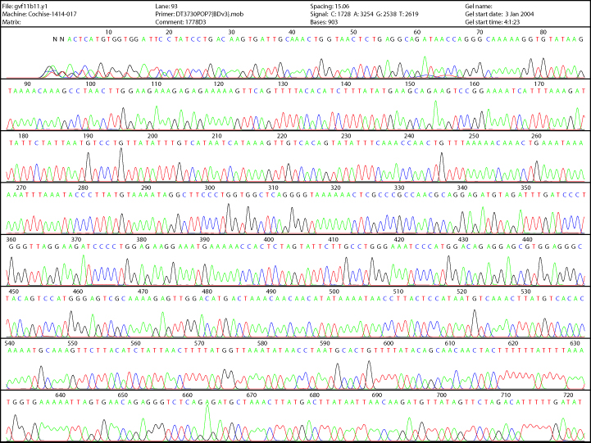
Objectives
Why R?
Reproducibility
Efficiency
Organization
Analysis changes
Team science
The learning curve
Image: NHGRI Division of Intramural Research www.genome.gov

Slide 3
Why R? -> Data complexity
Raw Data
Poster, Manuscript, Slide show presentation, website
Analysis
Useable Project Data
Raw Data
Raw Data
Adapted from Reproducible Research for R Figure 2 pg.

Slide 4
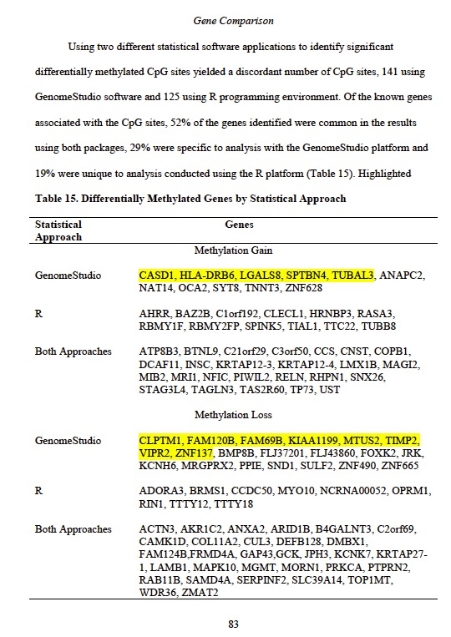
Why R?
Analytic pipelines
Wright ML (2014) Novel Approaches Investigating Predisposition for Maternal Group B Streptococcus Colonization
Taylor JY, Wright ML, Crusto, C & Sun Y. (2016) The Intergenerational Impact of Genetic and Psychological Factors on Blood Pressure Study (InterGEN): Design and Methods for Complex DNA Analysis, Biologic Research for Nursing 18 (5), pp. 521 - 530

Slide 5
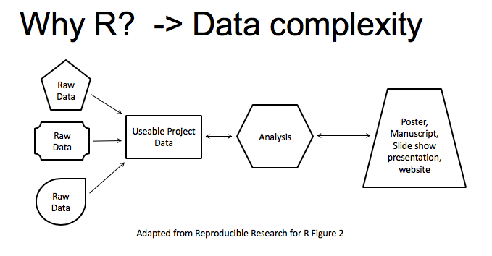


Why R?
Team Science

Slide 6
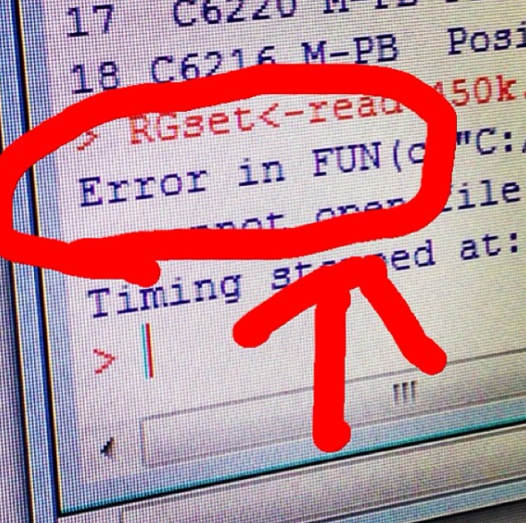
The learning curve

Slide 7
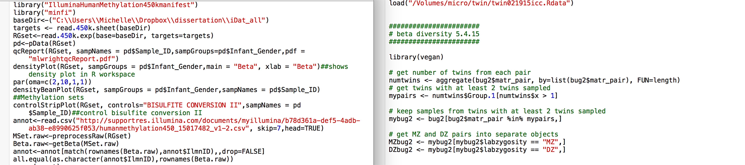
The learning curve

Slide 8
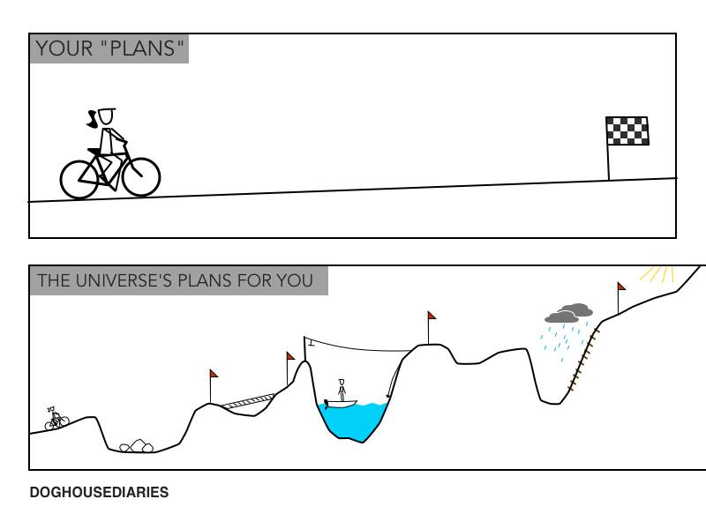
The learning curve

Slide 9
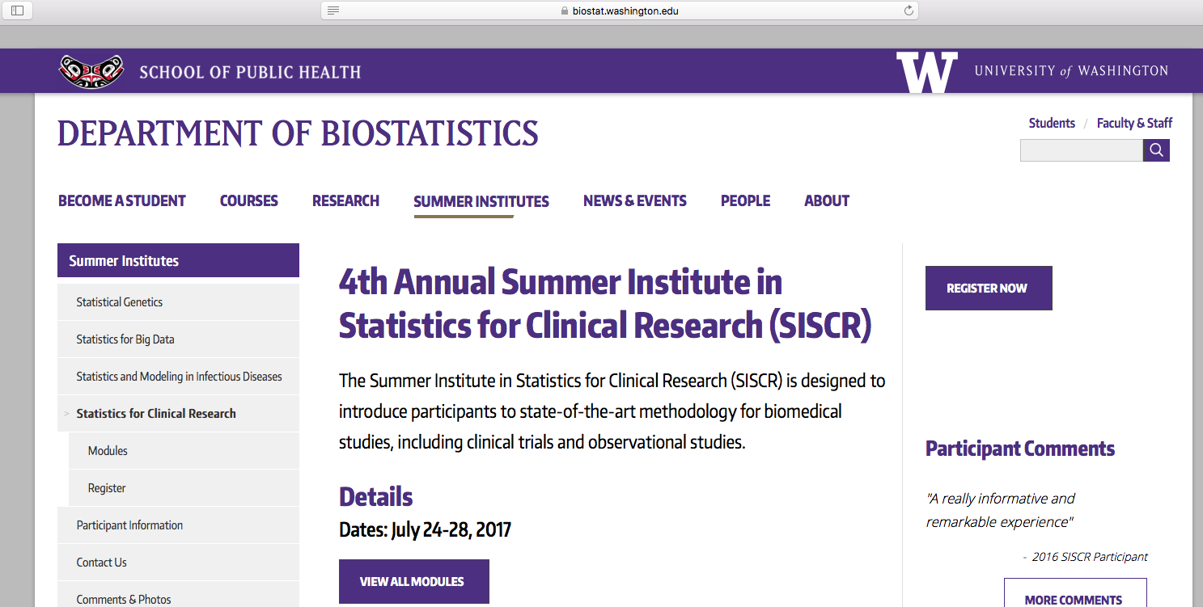
There is help!!
Stackoverflow
is your friend
Vignettes!
Download the
package
materials
Code outlined!
SISG

